Slide 1

Welcome To Our Presentation

Slide 2
Analysis of Algorithms

Slide 3
Group Member:
Name:Biplob Kumar Ghosh
ID:191-15-12928
Shakil Ahamed Sujon
ID:191-15-12936

Slide 4
Introduction
What is Algorithm?
  a clearly specified set of simple instructions to be followed to solve a problem
    Takes a set of values, as input and
    produces a value, or set of values, as output
  May be specified
    In English
    As a computer program
    As a pseudo-code
Data structures
  Methods of organizing data
Program = algorithms + data structures

Slide 5
Introduction
Why need algorithm analysis ?
  writing a working program is not good enough
  The program may be inefficient!
  If the program is run on a large data set, then the running time becomes an issue

Slide 6
Example: Selection Problem
Given a list of N numbers, determine the kth largest, where k ≤ N.
Algorithm 1:
  (1) Read N numbers into an array
  (2) Sort the array in decreasing order by some simple algorithm
  (3) Return the element in position k

Slide 7
Example: Selection Problem…
Which algorithm is better when
  N =100 and k = 100?
  N =100 and k = 1?
What happens when N = 1,000,000 and k = 500,000?
There exist better algorithms

Slide 8
Algorithm Analysis…
Factors affecting the running time
  computer
  compiler
  algorithm used
  input to the algorithm
    The content of the input affects the running time
    typically, the input size (number of items in the input) is the main consideration
      E.g. sorting problem ⇒ the number of items to be sorted
      E.g. multiply two matrices together ⇒ the total number of elements in the two matrices
Machine model assumed
  Instructions are executed one after another, with no concurrent operations ⇒ Not parallel computers

Slide 9
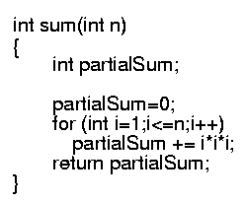
Example
Calculate
Lines 1 and 4 count for one unit each
Line 3: executed N times, each time four units
Line 2: (1 for initialization, N+1 for all the tests, N for all the increments) total 2N + 2
total cost: 6N + 4 ⇒ O(N)
1
2
3
4
1
2N+2
4N
1

Slide 10
Worst- / average- / best-case
Worst-case running time of an algorithm
  The longest running time for any input of size n
  An upper bound on the running time for any input
  ⇒ guarantee that the algorithm will never take longer
  Example: Sort a set of numbers in increasing order; and the data is in decreasing order
  The worst case can occur fairly often
    E.g. in searching a database for a particular piece of information
Best-case running time
  sort a set of numbers in increasing order; and the data is already in increasing order
Average-case running time
  May be difficult to define what “average” means

Slide 11
Running-time of algorithms
Bounds are for the algorithms, rather than programs
  programs are just implementations of an algorithm, and almost always the details of the program do not affect the bounds
Bounds are for algorithms, rather than problems
  A problem can be solved with several algorithms, some are more efficient than others

Slide 12
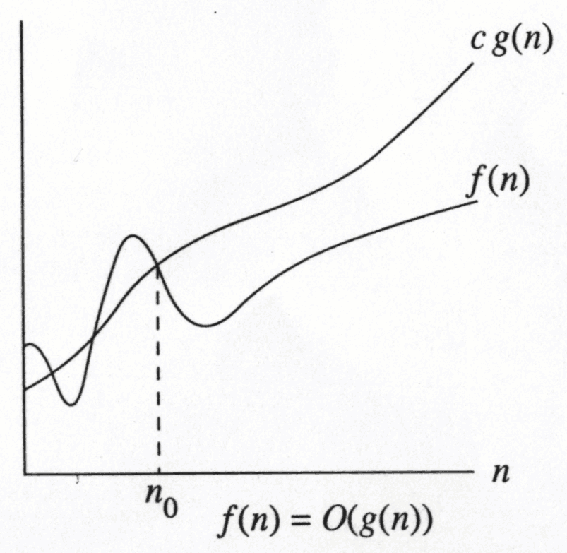
Growth Rate
The idea is to establish a relative order among functions for large n
∃ c , n₀ > 0 such that f(N) ≤ c g(N) when N ≥ n₀
f(N) grows no faster than g(N) for “large” N

Slide 13
Math Review: logarithmic functions

Slide 14
Some rules
When considering the growth rate of a function using Big-Oh
Ignore the lower order terms and the coefficients of the highest-order term
No need to specify the base of logarithm
  Changing the base from one constant to another changes the value of the logarithm by only a constant factor
If T₁(N) = O(f(N) and T₂(N) = O(g(N)), then
  T₁(N) + T₂(N) = max(O(f(N)), O(g(N))),
  T₁(N) * T₂(N) = O(f(N) * g(N))

Slide 15
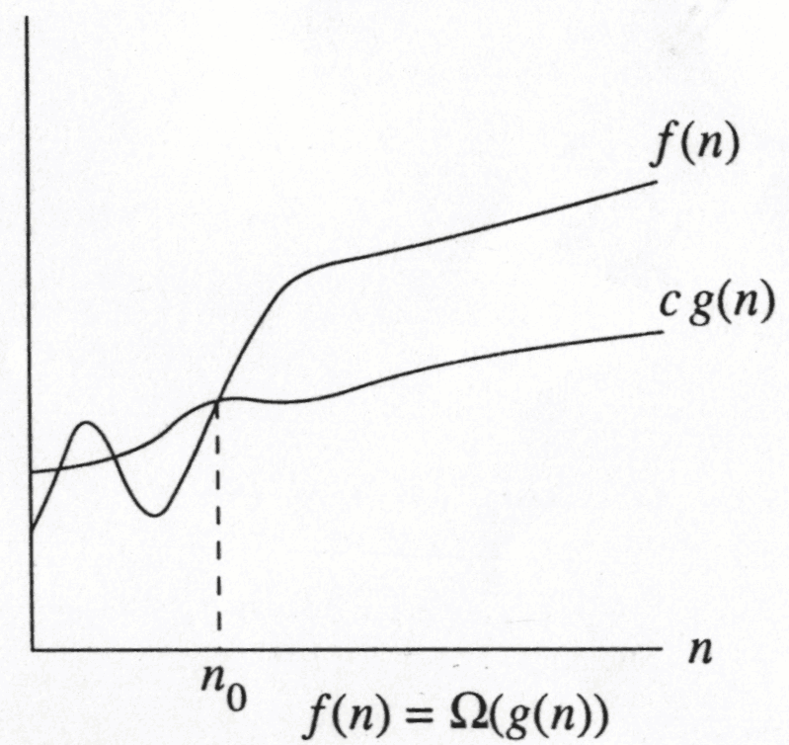
Big-Omega
∃ c , n₀ > 0 such that f(N) ≥ c g(N) when N ≥ n₀
f(N) grows no slower than g(N) for “large” N

Slide 16
Big-Omega: examples
Let f(N) = 2N². Then
  f(N) = Ω(N)
  f(N) = Ω(N²) (best answer)

Slide 17
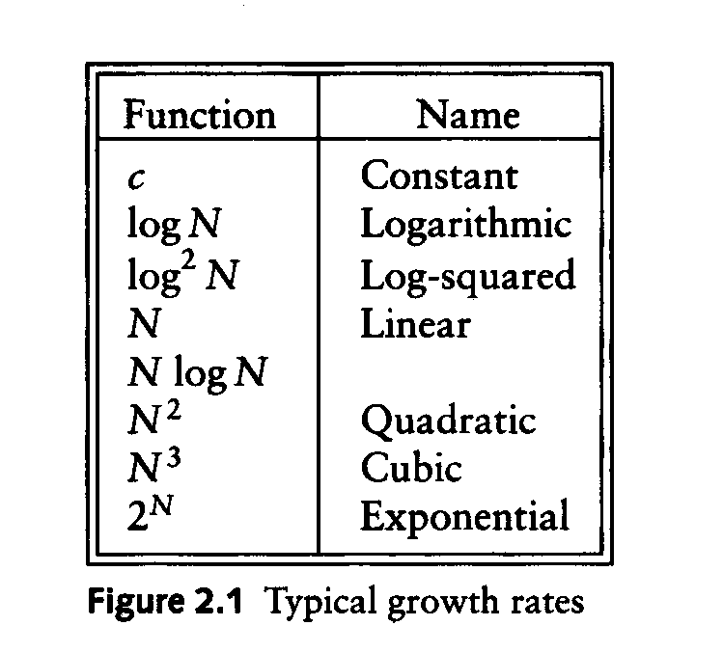
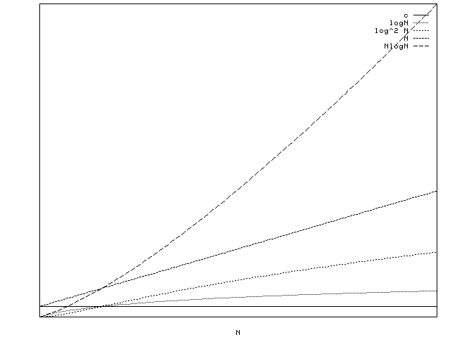
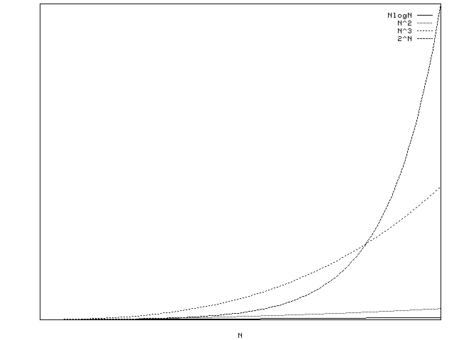
Typical Growth Rates

Slide 18
Growth rates …
Doubling the input size
  f(N) = c ⇒ f(2N) = f(N) = c
  f(N) = log N ⇒ f(2N) = f(N) + log 2
  f(N) = N ⇒ f(2N) = 2 f(N)
  f(N) = N² ⇒ f(2N) = 4 f(N)
  f(N) = N³ ⇒ f(2N) = 8 f(N)
  f(N) = 2^{N} ⇒ f(2N) = f²(N)
Advantages of algorithm analysis
  To eliminate bad algorithms early
  pinpoints the bottlenecks, which are worth coding carefully

Slide 19
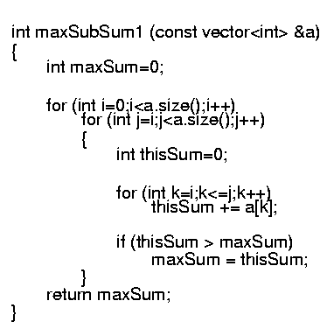
Algorithm 1: Simple
Exhaustively tries all possibilities (brute force)
O(N³)

Slide 20
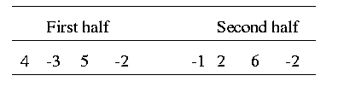
Algorithm 2: Divide-and-conquer
Divide-and-conquer
  split the problem into two roughly equal subproblems, which are then solved recursively
  patch together the two solutions of the subproblems to arrive at a solution for the whole problem
The maximum subsequence sum can be
  Entirely in the left half of the input
  Entirely in the right half of the input
  It crosses the middle and is in both halves

Slide 21
Algorithm 2 (cont’d)
Solving the recurrence:
With k=log N (i.e. 2^{k} = N), we have
Thus, the running time is O(N log N)
  faster than Algorithm 1 for large data sets

Slide 22
Thank You

